Slide 1
Informatisation of Education as a Social Driver for Sustainable Development in the Republic of Korea
K. P. Joo
Assistant Professor
Korea National Open University

Slide 2
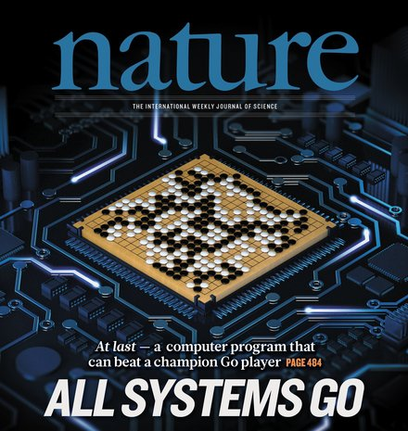
Toward Intelligent-Information Society
http://www.amc.com/shows/humans
Beyond
‘Artificial Intelligence’
Society
https://www.nature.com/

Slide 3
Informatisation of Education in the RoK
Five Objectives
2017 Vision
of the Ministry of Education
“Happy and Future-Oriented Education”
1
To grow students’ dream and talent
2
To grow students who meet social needs
3
To provide services for no child left behind
4
To provide comfortable environments
to students
5
To grow students to be global leaders

Slide 4
Informatisation of Education in the RoK
Systems
Primary & Secondary Education
Educational Administration
Informatisation
of
Education
Security
Higher Education
International Cooperation
Lifelong Education
Levels

Slide 5
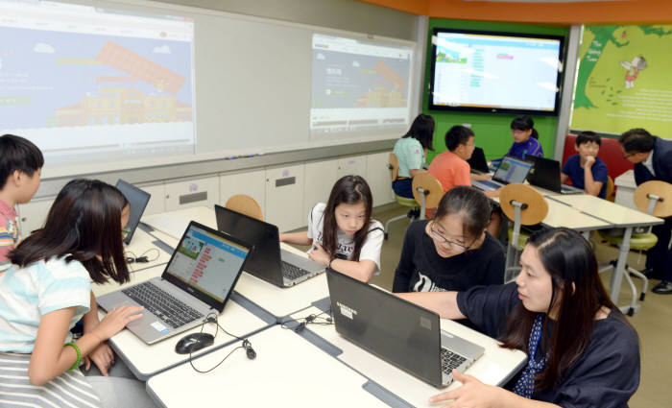
Informatisation of Education in the RoK - LEVELS
Primary & Secondary Education
Software Education
Required subject in the “2015 Revised Curriculum”
Teacher training for software education
Digital Textbook
Trial operation in 2007
Investigation of 128 schools using digital textbook
Career Information Website
“http://career.go.kr” for students, parents and teachers

Slide 6
Informatisation of Education in the RoK - LEVELS
Hifelong Education
Cyber Universities
Lifelong education facility using online technologies
Over 100,000 students in 21 institutions
Korea Open Courseware (KOCW)
OERs from Korean higher education institutions
Developed into K-MOOC
Research Information Sharing Service
Provision of research information to various users
Pariticipation of All four-year universities

Slide 7
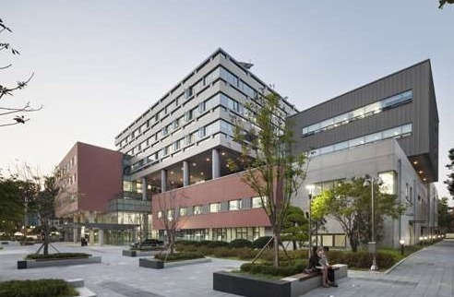
Informatisation of Education in the RoK - LEVELS
Lifelong Education
Korea National Open University
First and unique national distance higher education institution
Provision of lifelong education programs as well as undergraduate and graduate degree programs
Online and mobile learning platforms
Digital textbooks

Slide 8
Informatisation of Education in the RoK - SYSTEMS
ADMIN
National Education Information System (NEIS)
EDUFINE: Financial Management System for Local School Districts
SECURITY
Operation of ‘Cyber Security Center’
Training on “The Personal Information Protection Law” to students and parents
INTERNATIONAL COOPERATION
E-Learning Globalization Project, ICT Classroom Building Project, ASEAN E-Learning Innovation Project in 29 countries

Slide 9
For SDGs

Slide 10
kpjoo@knou.ac.kr
Thank You

