Slide 1
Technology-enhanced teaching and learning: experiences from a teacher training distance course
“Theory Meets Practice: Teacher Training in the Digital Era”
ASEM Education and Research Hub for Lifelong Learning Conference &
13th ASEF Classroom Network (ASEF ClassNet) Conference
8-10/11 September 2017, Zug, Switzerland
Dr. Inés Gil-Jaurena
Associate Professor, Faculty of Education
Universidad Nacional de Educación a Distancia (UNED) - Spanish National Distance Education University
© 2017 - Inés Gil Jaurena - CC-BY-SA

Slide 2
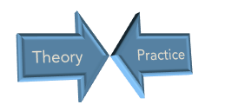
Dichotomized world that separates:
Another logic
Collective construction of knowledge
From experience and reflection
Contextualization, inquiry, reflection
Reflective practice
© 2017 - Inés Gil Jaurena - CC-BY-SA

Slide 3
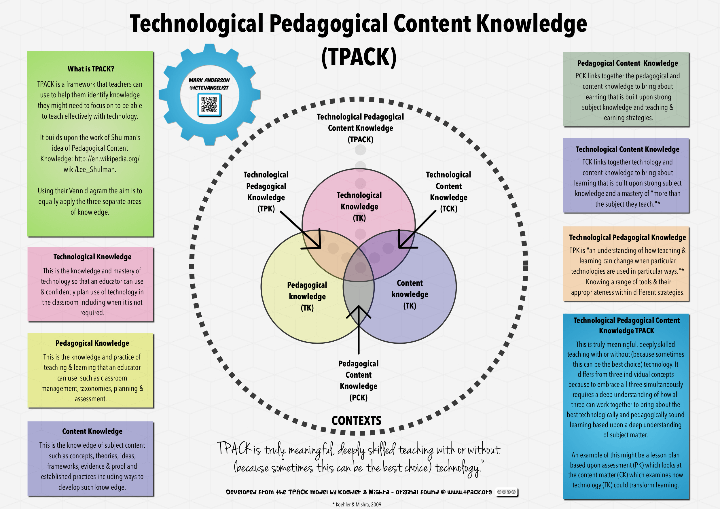

Slide 4
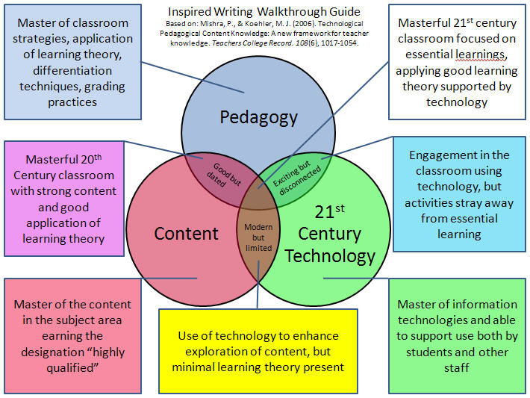

Slide 5
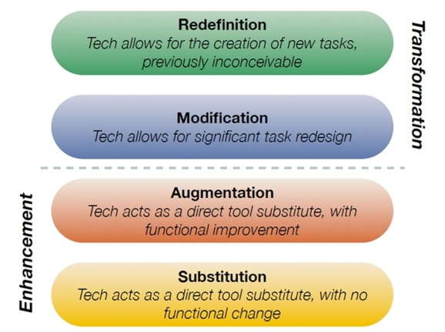

Slide 7
Technologies / tools
In a LMS
Forums: for interaction, knowing each other, debates, …
Surveys: for initial knowledge, collecting suggestions,
Quizes: online test
Upload documents (professors) and assignments (students)
Videoconference
In an open online environment
Collaborative documents, wikis
Blogs: for debates, opinions
Social networks: for interaction, creating interest groups
Deliberation tools: for debate, consensus, making decisions
e-portfolios: for compilation of individual works and reflections
…
© 2017 - Inés Gil Jaurena - CC-BY-SA

Slide 8
UNED. Some figures
Largest university in Spain
Founded in 1972
Function: Facilitate access to university and continuation of studies to any person able to follow higher education
Some figures (2016-17):
137,227 Bachelor students
8,850 Master students
1,945 Doctoral students
14,475 Language students
11 Faculties in Madrid
78 Academic Departments
61 Regional + more than 100 extensions and classrooms Centres in Spain
27 bachelor's degrees
74 official master's degrees
62 doctoral programmes
14 languages courses
+ 600 distance courses continuing education programme
+ MOOCs
© 2017 - Inés Gil Jaurena - CC-BY-SA

Slide 9
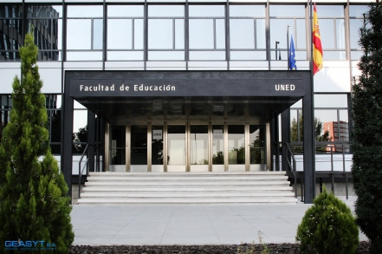
UNED. Faculty of Education
5 Academic Departments
2 bachelor's degrees: Pedagogy and Social Education
9 official master's degrees:
Innovation and Research in Education
Diversity in Education
Communication and Education
Teacher Education (secondary)
Strategies and technologies for teaching in multicultural societies
Euro-Latinamerican Master in Intercultural Education
Vocational guidance
History, memory and analysis
Education in social contexts
1 doctoral programme
11,600 students (2016-17)
Master Teacher education: 1,204
ISC: 50
Master Intercultural education: 79
© 2017 - Inés Gil Jaurena - CC-BY-SA

Slide 10
Two master courses in distance mode
Master programme in Teacher Education (secondary and VET)
Socio-community intervention specialty
Course on Foundations of socio-community intervention
Master programme in Intercultural Education
Course on Project design and evaluation
© 2017 - Inés Gil Jaurena - CC-BY-SA

Slide 11
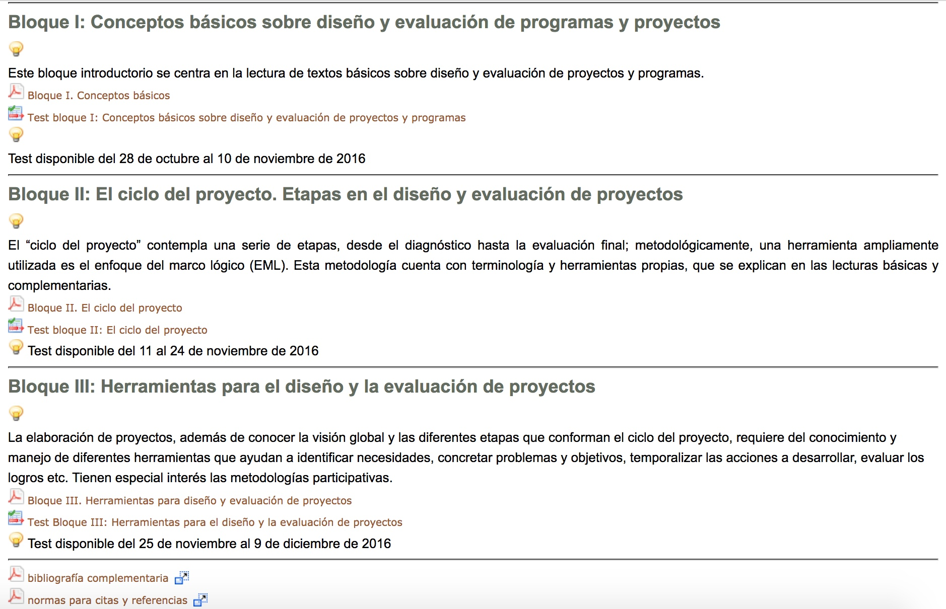
Virtual course homepage
© 2017 - Inés Gil Jaurena - CC-BY-SA

Slide 12
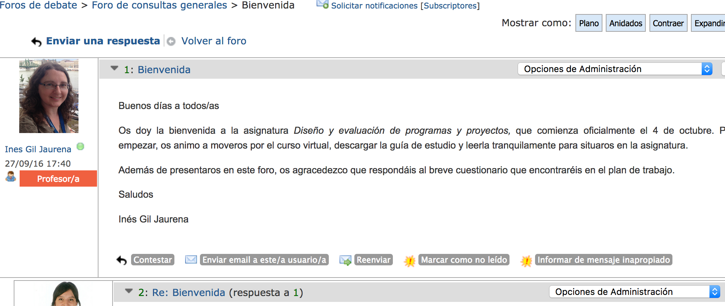
Forums in online courses for interaction
Introduce and know each other
Meet the group
Facilitate participatory climate
Curiosity towards other learners profiles
Listening / reading other’s contributions
© 2017 - Inés Gil Jaurena - CC-BY-SA

Slide 13
Synchronous videoconference with students
© 2017 - Inés Gil Jaurena - CC-BY-SA

Slide 14
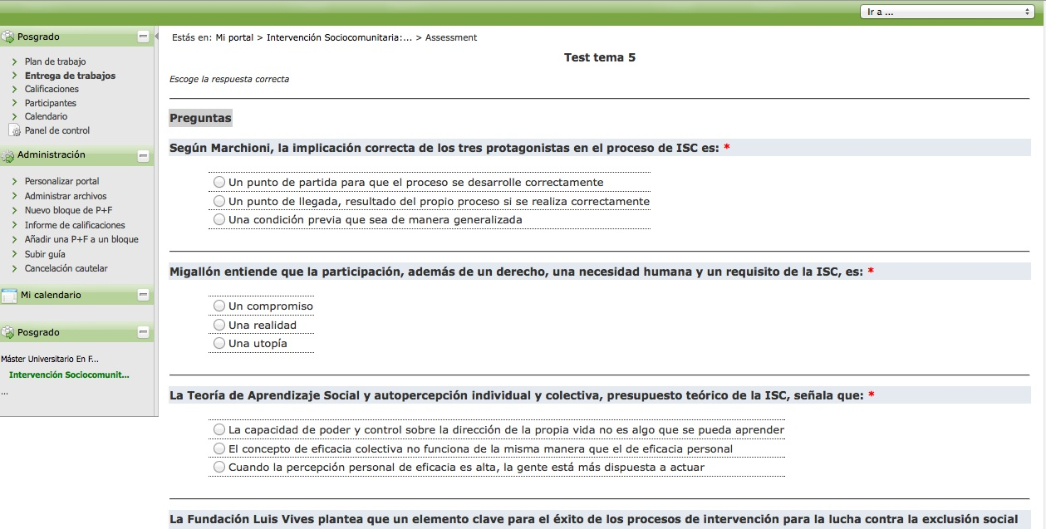
Online test in ISC master course
© 2017 - Inés Gil Jaurena - CC-BY-SA

Slide 15
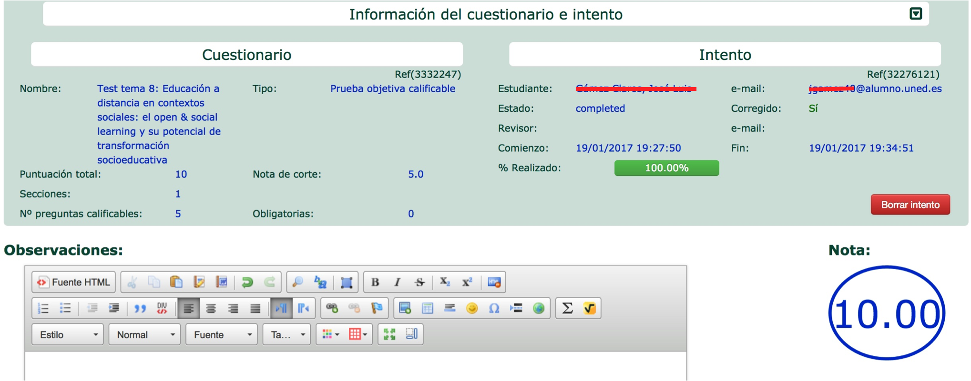
Professor’s interface in an online test
© 2017 - Inés Gil Jaurena - CC-BY-SA

Slide 16
Forums in online courses for an assignment
Case a) analysis of a practical case in Project design master course
Participate, express opinions
Listening / reading other’s contributions
Confront opinions, discuss
Case b) construction of a collaborative glossary in ISC master course
Collectively decide about relevant terms and their definitions
Participate, express opinions
Listening / reading other’s contributions
Confront opinions, reach consensus
© 2017 - Inés Gil Jaurena - CC-BY-SA

Slide 17
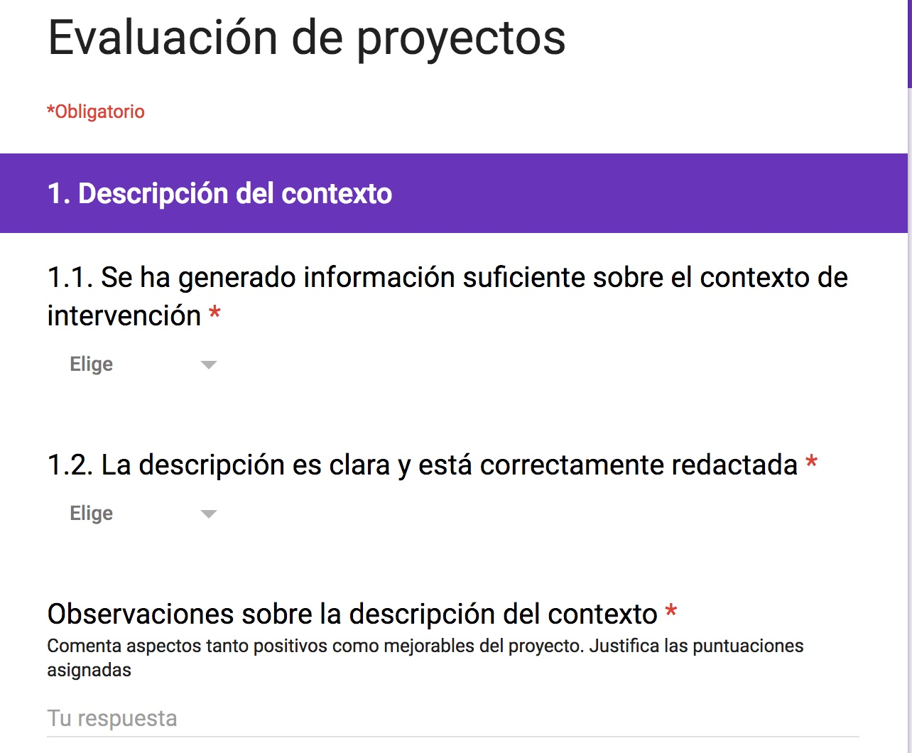
Online peer-assessment in a master course
Critically analyze a project designed by another learner
Provide constructive comments to another learner
Accept other learner’s critique
© 2017 - Inés Gil Jaurena - CC-BY-SA

Slide 18
Success rates in two master courses
Table 1. Enrollment, assessment and success rates in two courses, from 2012-13 to 2016-17
 | Teacher education Master: ISC |  |  |  | Intercultural education Master: Project design
Year | Students | Assessment rate | Success rate |  | Students | Assessment rate | Success rate
2012-13 | 34 | 91,18 | 100 |  | 20 | 60 | 100
2013-14 | 26 | 73,08 | 100 |  | 22 | 54,55 | 100
2014-15 | 40 | 80 | 96,88 |  | 22 | 77,27 | 100
2015-16 | 39 | 92,31 | 100 |  | 19 | 57,89 | 100
© 2017 - Inés Gil Jaurena - CC-BY-SA

Slide 19
Students’ satisfaction in two master courses
Tabla 2. Students’ satisfaction with two courses, from 2012-13 to 2016-17. Max: 100
 | Teacher education Master: ISC |  |  | Intercultural education Master: Project design
 | Students’ satisfaction with the course | Students’ satisfaction with the Master |  | Students’ satisfaction with the course | Students’ satisfaction with the Master
2012-13 | 97,83 | 66,89 |  | 100 | 90,94
2013-14 | 92,78 | 77,80 |  | 100 | 94,60
2014-15 | 98,81 | 71,10 |  | 94,61 | 88,94
2015-16 | 97,73 | 68 |  | 94,92 | 91,61
2016-17 | 80,14 | 62,60 |  | 87,83 | 82,05
© 2017 - Inés Gil Jaurena - CC-BY-SA

Slide 20
Challenges and proposals
Enhancement of digital content (different formats, interactive, annotations, …).
Improvement of e-assessment tools: online exams, self and peer assessment tools.
Collaborative learning: tools for group activities development and monitoring.
Feedback to learners: technological solutions for richer feedback (rubrics, automatic feedback, …).
…
Augmentation (A)
Modification (M)
Redefinition (R)
© 2017 - Inés Gil Jaurena - CC-BY-SA

Slide 21
Thank you for your attention! Inés Gil Jaurena inesgj@edu.uned.es
“Theory Meets Practice: Teacher Training in the Digital Era”
ASEM Education and Research Hub for Lifelong Learning Conference &
13th ASEF Classroom Network (ASEF ClassNet) Conference
8-10/11 September 2017, Zug, Switzerland
How would you integrate ICT in your teaching?
Which level in the SAMR model would you reach?
© 2017 - Inés Gil Jaurena - CC-BY-SA

