Slide 1
Leading Impactful Professional Learning Communities
ASEM LLL Hub & 13th ASEF ClassNet Conference
Theory Meets Practice: Teacher Training in the Digital Era
Zug, Switzerland
Hairon Salleh
National Institute of Education
Nanyang Technological University
9 Sep 2017

Slide 2
Education Reform Context
Pace of Change
Diverging Identities
Capacity Building
Teachers
Curriculum
Pedagogy
Assessment
Leaders
Instructional leadership
Distributed leadership
Teacher Leadership
Policy Demands
Diverse and expanded learning outcomes (e.g., 21CC)
School-Based Curriculum Development
Innovations in Curriculum, Pedagogy & Assessment
GAP
School Capacity
Digital Technologies
VUCA World
Complexities

Slide 3
Capacity Building
?
More resources to increase output?
Same output with less resources?

Slide 4
Capacity Building
Focus!
Professional Learning through PLCs
Teachers
Leaders
Distributed Instructional Leadership through
Teacher Leaders

Slide 5
Teacher Learning
Action Research
Lesson Study
Mentoring
Collective Learning
Coaching
Professional Learning Communities
Network Learning Communities
Communities of Practice
Learning (etc) Communities

Slide 6
Practice
Distributed Instructional Leadership
Senior Leaders
(P / VP)
Middle Leaders
(SH, YH, HOD)
Formal
(STs, LTs) .
Teacher Leaders
Informal
(PLC Team Leader, Subject Coords, Level Coords)
PLCs
Teaching Practices
Student Learning

Slide 7
Features of Effective PLCs
Lieberman & Miller (2011, p. 19)

Slide 8
Research Evidences
2012-2017
2 STUDIES
RESEARCH
FINDINGS
PLCS
DISTRIBUTED LEADERSHIP

Slide 9
Study 1: PLCs Impact on PLCs
Quasi-Exp
EXP (T4-T1)
 | T₁ |  | T₂ |  | T₃ |  | T₄
EXP | O₁ | X | O₂ | X | O₃ | X | O₄
CON | O₁ |  | O₂ |  | O₃ |  | O₄
Rate of growth of EXP P5 students statistically higher than CON P5 students (p < .05), small effect size (0.124)
CON d (T4-T1)
Sample: 9 primary school | 3 Experiment 6 Control | 1389 50 Primary 5 Students

Slide 10
Study 1: PLCs Impact on PLCs
6. Organisational support strengthening the capacity of PLC practices impacting on teacher teaching practices enhancing PLC effectiveness
FGDs
Organizational Support
4. Assessment data insights to individual students’ learning determine effectiveness of instructional practice and refine individual teachers’ instructional practice enhancing PLC effectiveness
2. Collective learning enhancing PLC effectiveness
3. Collective learning translating to collective teaching approaches, but individualised in teaching practice enhancing PLC effectiveness.
Teaching Practice
Student Outcomes
PLC
5. Teacher leadership enhancing PLC effectiveness
1. PLCs impact on student learning is indirect through teaching practice – a pragmatic need
Sample: 11 primary school | 22 FGDs | 11 SLs, 11 Math HODs, 50 Primary 5 Math Teachers

Slide 11
Study 1: PLCs Impact on PLCs
Teacher Leadership
Influence towards shared goals on student learning
Collegial and collaborative relations
Teacher learning and development
Change in teachers’ teaching practices

Slide 12
Study 1: PLCs Impact on PLCs
Teacher Level Predictors
Students’ Learning Growth in P5 Math
Student Level Predictors
Regression
Coefficient
Predictors
Outcome
HLM
Sample: 7 primary school | 35 Math PLCs | 1108 primary 5 students

Slide 13
Study 1: PLCs Impact on PLCs

Slide 14
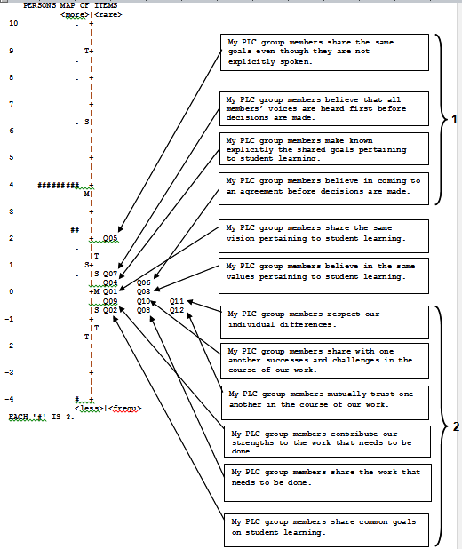
Study 1: PLCs Impact on PLCs
Articulation of common goals on student learning
Collegial sharing and collaboration
Rasch Analysis

Slide 15
Study 2: Predictors of Student Learning Growth
HLM
Sample: 28 primary school | 58 SLs | 93 Math Teachers | 1778 primary 5 students

Slide 16
Study 2: Predictors of Student Learning Growth
Distributed Leadership
Bounded Empowerment (More further empowering) - 2.170 *
Developing Leadership 4.041 ***
Collective Engagement (More synergistic collaborations) - 2.650 *
Teacher Leadership
Promote Professional Learning (Value it but not practice it) - 2.738 *
Change in Classroom Teaching Practices 3.214 **
Collective Learning
Reflecting Knowledge (Greater initiative to share practices) - 2.777 *
Applying Knowledge 2.544 *
Innovating Knowledge (Greater risk-taking and trust) - 2.319 *
Teaching Competencies
Curriculum Content Knowledge 2.192 *
Pedagogical Knowledge 2.582 *

Slide 17
Study 2: Predictors of Student Learning Growth
CL
Reflecting Knowledge
0.61***
(0.10)
- 0.40
(0.34)
0.63***
(0.09)
0.71***
(0.10)
0.66***
(0.08)
0.27
(0.25)
DL
Empowerment
TL
Teaching practices
CL
Interrogating Knowledge
Student Growth
0.42*
(0.18)
0.16
(0.11)
0.33*
(0.14)
CL
Applying Knowledge
Goodness-of-Fit Statistics
(No. of students = 1679, schools = 28)
Chi-Square / df / p-value | 90.636 / 15 / .000
CFI/ TLI | 1.000 / 1.023
RMSEA | .000
SRMR | .043
Multi-Level Path Analysis

Slide 18
Key Levers
TEACHER
LEADERSHIP
COLLECTIVE LEARNING
I – trust – We
Inter-Dependent Synergy
COMMUNITY
Diverse – specific learning goals – Diverse
Purpose-Mission
ASSESSMENT
Teaching – link – Learning
Evidence-Based
PRAXIS
Classroom – PLC – Classroom
Practice-Theory-Practice

Slide 19
References

Slide 20
References

Slide 21
References

Slide 22
References

Slide 23
Hairon Salleh
hairon.salleh@nie.edu.sg

